Slide 1
UNIT-1
Agile and Scrum Principles

Slide 2
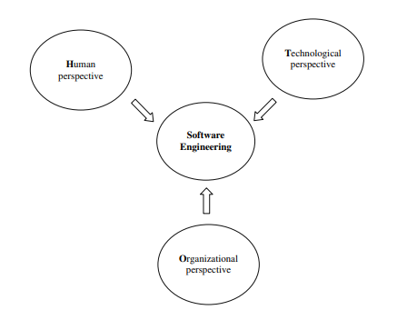
Three Perspectives of software engineering
Human perspective
Organizational perspective
Technological perspective

Slide 3
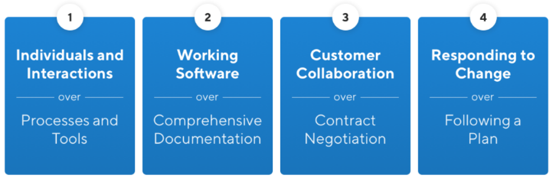
Agile Manifesto
The Agile Manifesto is a document that identifies four key values and 12 principles that its authors believe software developers should use to guide their work.

Slide 4
Agile Principles
Satisfy Customers Through Early & Continuous Delivery
Welcome Changing Requirements Even Late in the Project
Deliver Value Frequently
Business people and developers must work together daily throughout the project
Build Projects Around Motivated Individuals
Communicate Face-to-face
Working Software is the Primary Measure of Progress
Maintain a Sustainable Working Pace
Continuous attention to technical excellence
Simplicity
Self-organizing Teams
At regular intervals, the team reflects on how to become more effective, then tunes and adjusts its behavior accordingly.

Slide 5
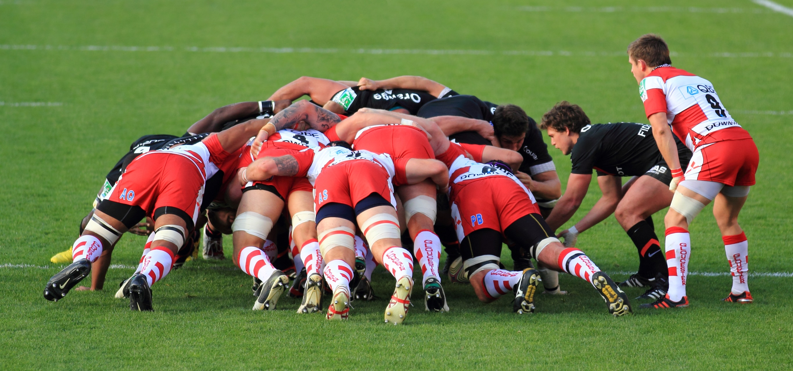
Elaborate your view…..

Slide 6
Scrum
Scrum is a framework that helps teams work together. Much like a rugby team training for the big game, scrum encourages teams to learn through experiences, self-organize while working on a problem, and reflect on their wins and losses to continuously improve.
Scrum Team
A scrum team is a group of collaborators, typically between five and nine individuals, who work toward completing projects and delivering products.
One scrum master,
One product owner and
A group of developers.

Slide 7
Basic Definitions
A Sprint is a short, time-boxed period when a scrum team works to complete a set amount of work.
A Product backlog is a prioritized list of work for the development team that is derived from the roadmap and its requirements. The most important items are shown at the top of the product backlog so the team knows what to deliver first
A Sprint backlog is a subset of the product backlog and lists the work items to complete in one specific sprint. The purpose of the sprint backlog is to identify items from the product backlog that the team will work on during the sprint.

Slide 8
Scrum Events
Sprint Planning
Daily Scrum
Sprint Review
Sprint Retrospective
The Sprint

Slide 9
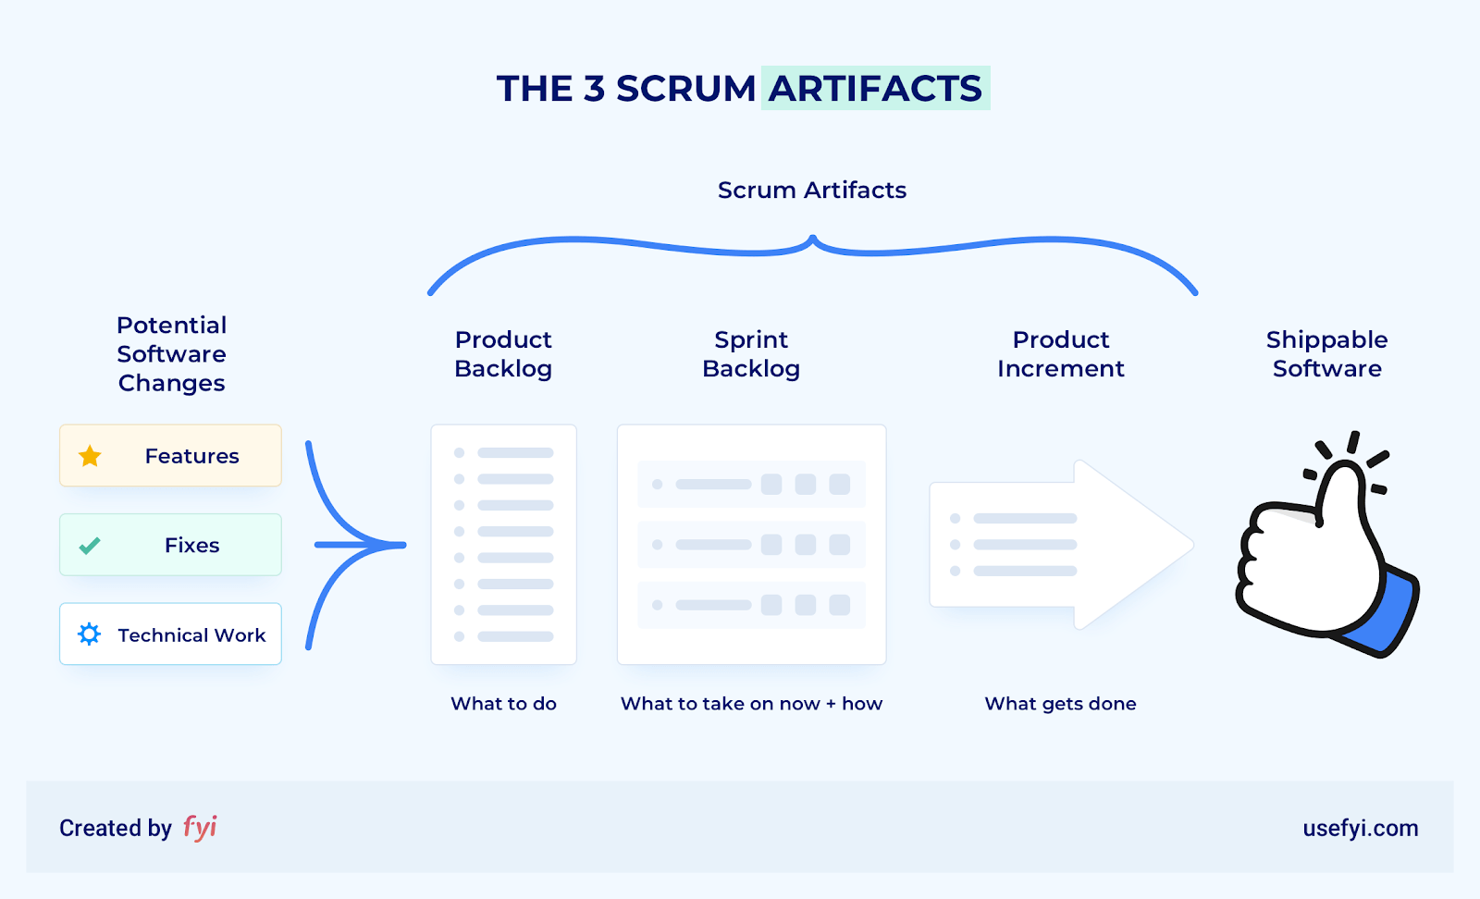

Slide 10
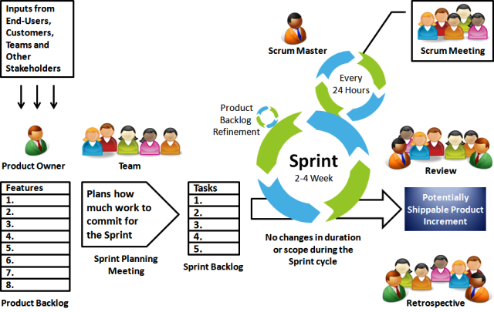
Scrum Process

Slide 11
Uses of scrum
Scrum can help teams complete project deliverables quickly and efficiently
Scrum ensures effective use of time and money
Large projects are divided into easily manageable sprints
Developments are coded and tested during the sprint review
Works well for fast-moving development projects
The team gets clear visibility through scrum meetings
Scrum, being agile, adopts feedback from customers and stakeholders
Short sprints enable changes based on feedback a lot more easily
The individual effort of each team member is visible during daily scrum meetings

Slide 12
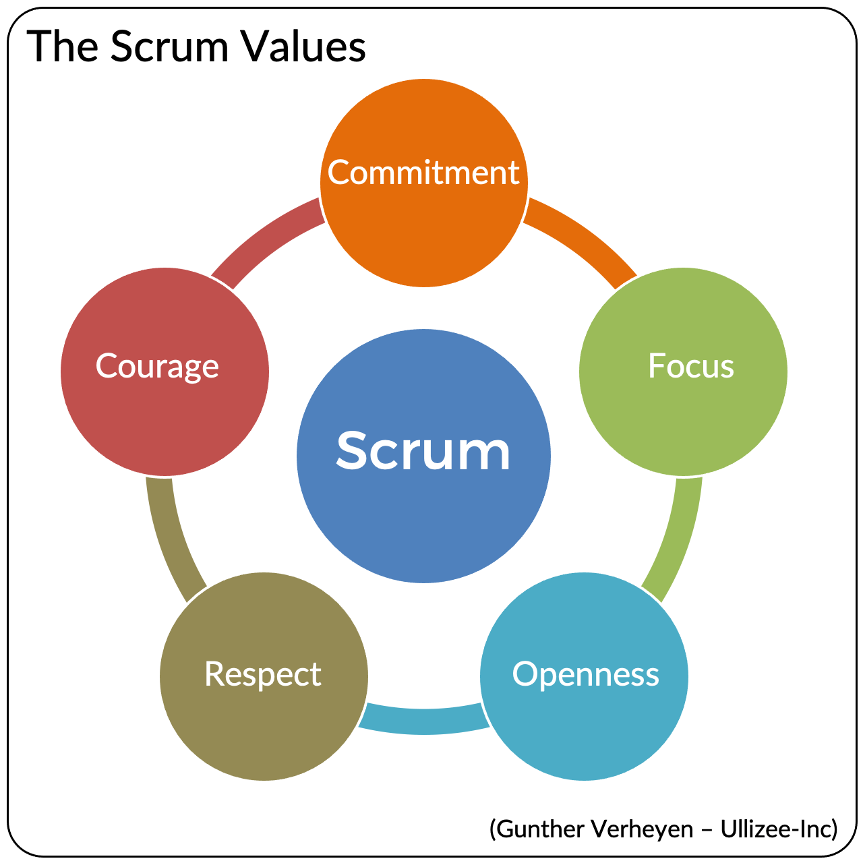

Slide 13
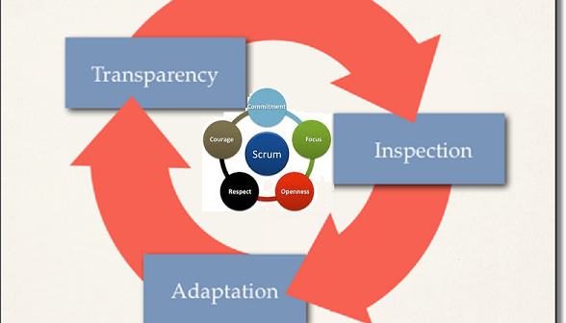
Scrum Theory

Slide 14
Kanban
Kanban is a popular framework used to implement agile and DevOps software development. It requires real-time communication of capacity and full transparency of work. Work items are represented visually on a kanban board, allowing team members to see the state of every piece of work at any time.

Slide 15
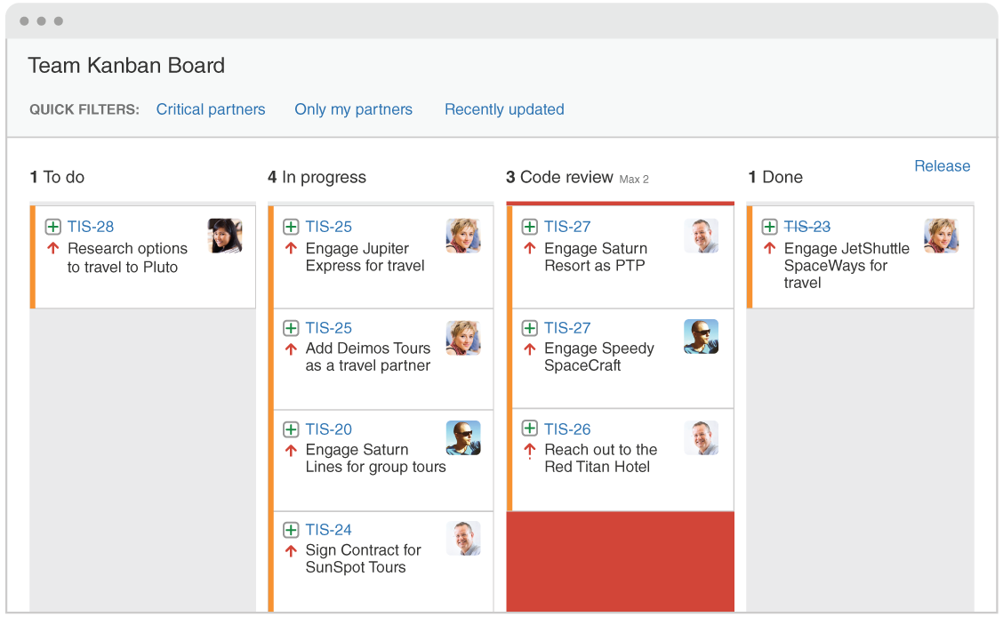

Slide 16
Scrum Vs Kanban
 | Scrum | Kanban
Origin | Software development | Lean manufacturing
Ideology | Learn through experiences, self-organize and prioritize, and reflect on wins and losses to continuously improve. | Use visuals to improve work-in-progress
Cadence | Regular, fixed-length sprints (i.e. two weeks) | Continuous flow
Practices | Sprint planning, sprint, daily scrum, sprint review, sprint retrospective | Visualize the flow of work, limit work-in-progress, manage flow, incorporate feedback loops
Roles | Product owner, scrum master, development team | No required roles

Slide 17

Teamwork
Teamwork is the collaborative effort of a group to achieve a common goal or to complete a task in the most effective and efficient way.

Slide 18
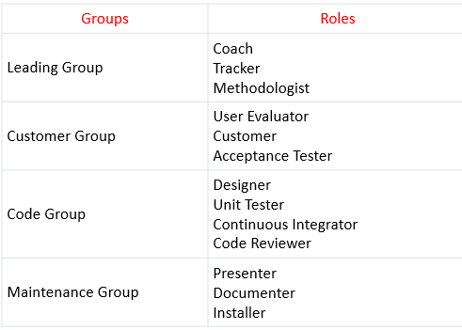
Role Scheme

Slide 19
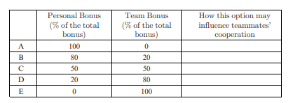
Dilemmas in Teamwork
How to allocate incentives, rewards, and bonuses among team member?

Slide 20
Teamwork in Learning Environments
Assign Roles to Team Members.
Role Activities
Role Assignment Activities
Role Maintenance Activities
Role Improvement Activity

